Slide 1
Processor 1
Processor 2
Processor 3

Slide 2
Processor 1
Processor 2
Processor 3

Slide 3


Grid as ones and zeros
Grid as stars and blanks

Slide 4
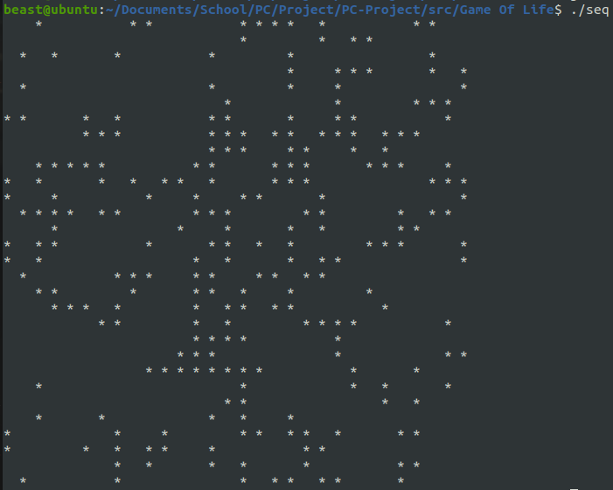
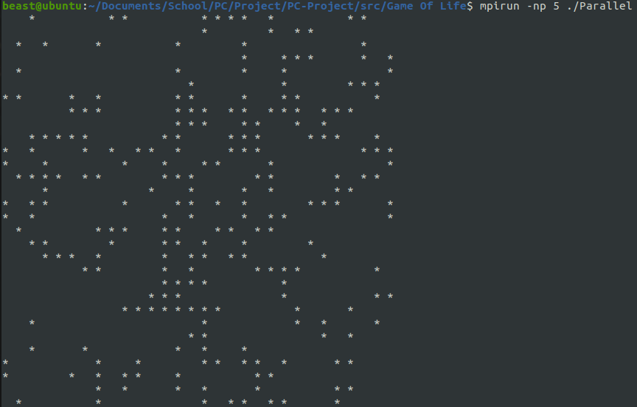
Sequential after gen 0
Parallel after gen 0

Slide 5
Size (n)
Serial
Parallel – (num processors)
10
0.000097s
0.000125s – (6)
20
0.000189s
0.000340s – (6)
30
0.000223s
0.000144s – (6)
40
0.000394s
0.000227s – (6)
50
0.000503
0.000231s – (4)
70
0.001024s
0.000656s – (4)
85
0.001535s
0.000541s – (4)
100
0.001603s
0.000623s – (4)
Table – comparison of serial vs parallel implementation
Size (n)
Serial
Parallel – (num processors)
Speedup
Efficiency
10
0.000097s
0.000125s – (6)
0.776
0.13
20
0.000189s
0.000340s – (6)
0.556
0.09
30
0.000223s
0.000144s – (6)
1.549
0.26
40
0.000394s
0.000227s – (6)
1.736
0.29
50
0.000503
0.000231s – (4)
2.177
0.54
70
0.001024s
0.000656s – (4)
1.561
0.39
85
0.001535s
0.000541s – (4)
2.837
0.71
100
0.001603s
0.000623s – (4)
2.573
0.64
Table – serial time , parallel time, speedup and efficiency

